Slide 1
CS3249
TeamQX

Slide 2
Microscope
Bob Wong Wei Jie
Kit Wei Min
Oh Qi Xuan

Slide 3
Objective
To make the user interface as intuitive as possible
To reduce the number of steps needed for the user to get to the end result

Slide 4
GUI Design
Notes:
The Microscope’s main feature is the Image Preview. Therefore, our GUI is focused on allocating as much space as possible to the Image Preview

Slide 5
Main Functionalities
Preview screen with real-time view
Easier to make adjustments
Large Preview screen
More details can be shown

Slide 6
Main Functionality
Viewing of past scans in main window
More manageable to not have multiple windows

Slide 7
Main Functionality
Combo view
Allows for comparision between live preview and past scans

Slide 8
Demonstration
Please wait while we bring up the Microscope. Probably in the background.

Slide 9
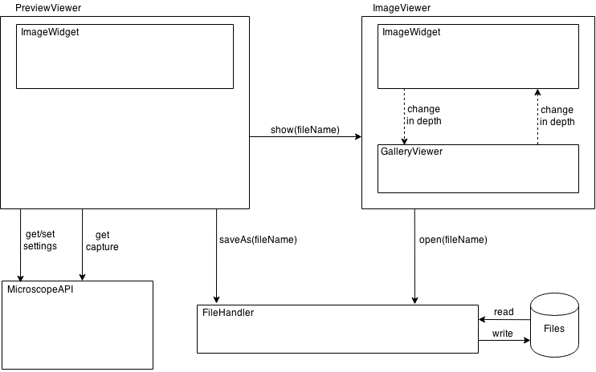
Software Architecture

Slide 10
Implementation Strategy
PreviewViewer => QMainWindow
Default view when the Microscope is opened
ImageViewer => QWidget
Can be shown and hidden in the main window, for the combo view
ImageWidget => Qwidget
Child widget of PreviewViewer and ImageViewer

